Slide 1
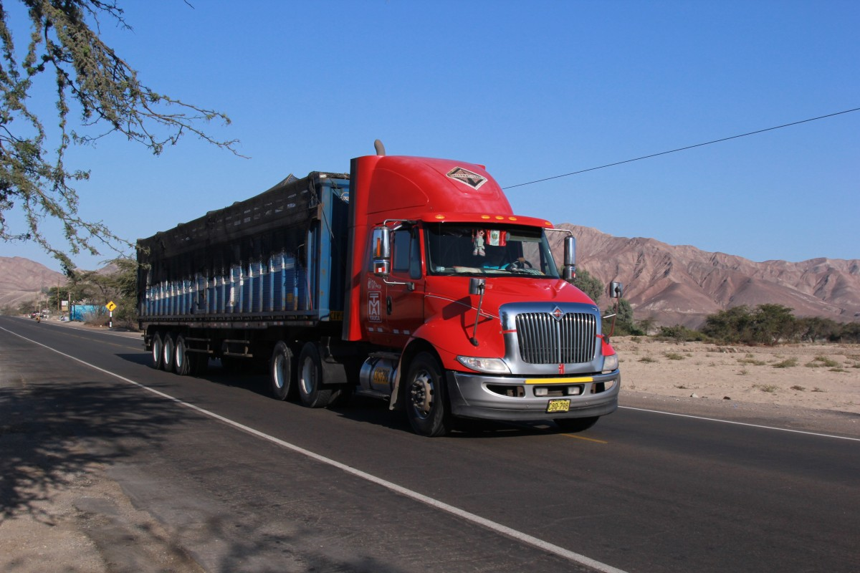
BIG DATA: Truck Project
BUAN 6346.001
Group 5
Akriti Verma
Almitha Veigas
Manisha Varma
Milind Wadhwa
Neelavarun Vemuri
Sriram Vegesana

Slide 2
OBJECTIVE
Analyze fleet data to better understand truck movement and risk factors
Which truck has the highest risk factor based on geographical location and time?

Slide 3


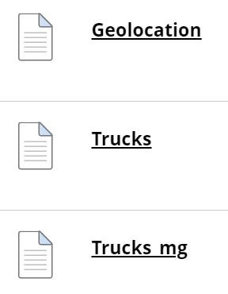



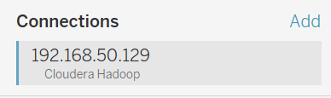
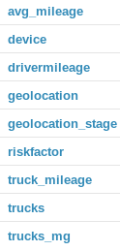
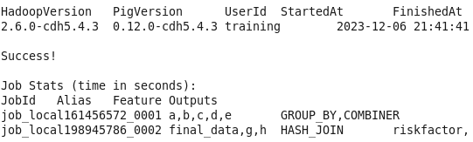
Start
Conclusion
Downloading the files
Using R/Python to find insights
Using Tableau to find insights
Loading data into HDFS
Integrating Hadoop with Tableau
Creating the tables
Populating the risk factor table

Slide 4
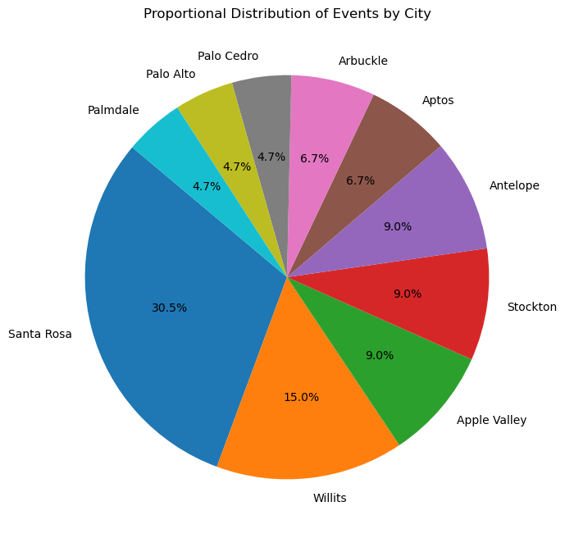
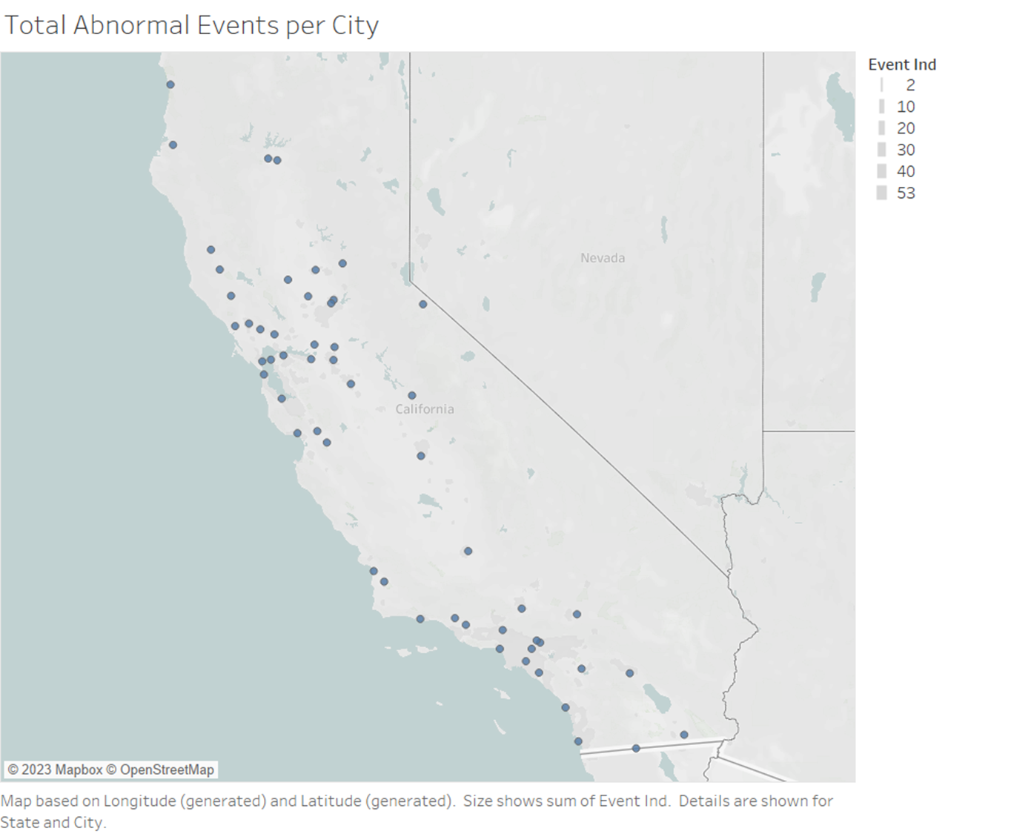
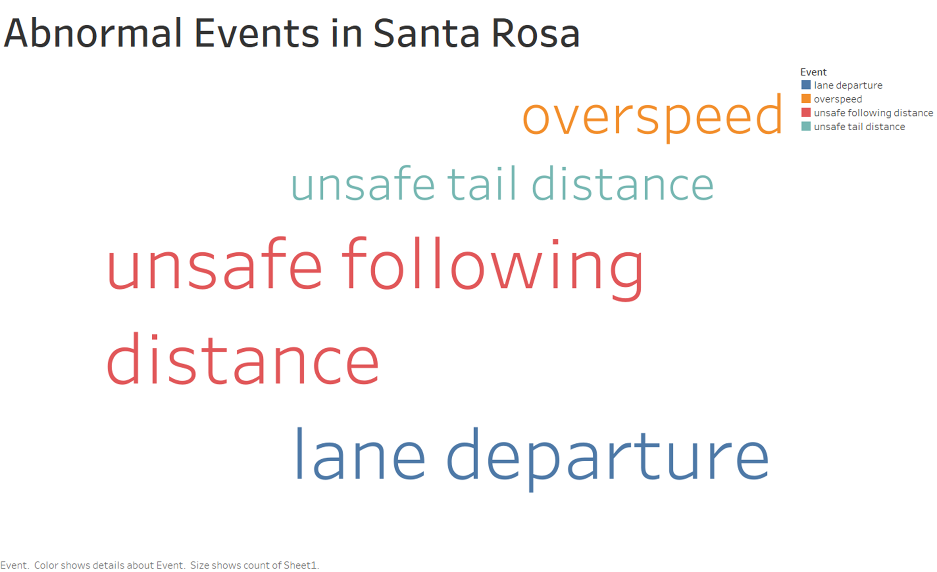
GEOGRAPHICAL ANALYSIS

Slide 5
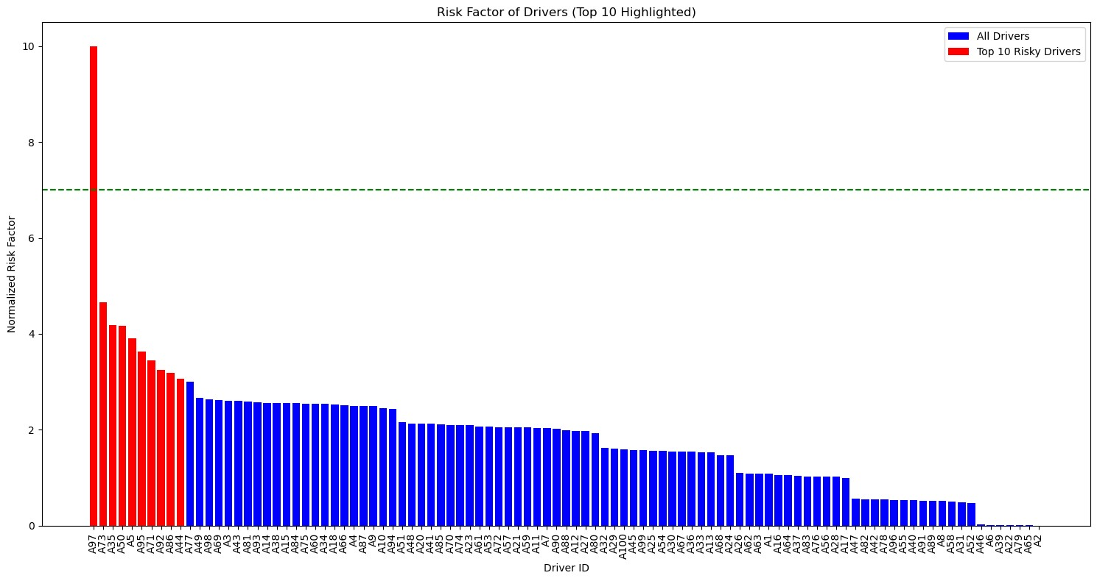
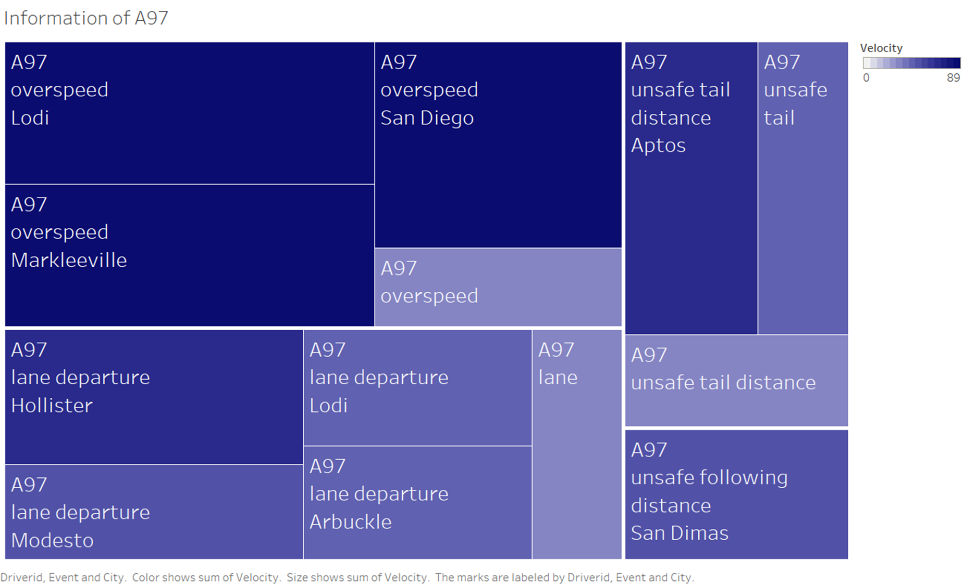
TOP 10 RISKY DRIVERS

Slide 6
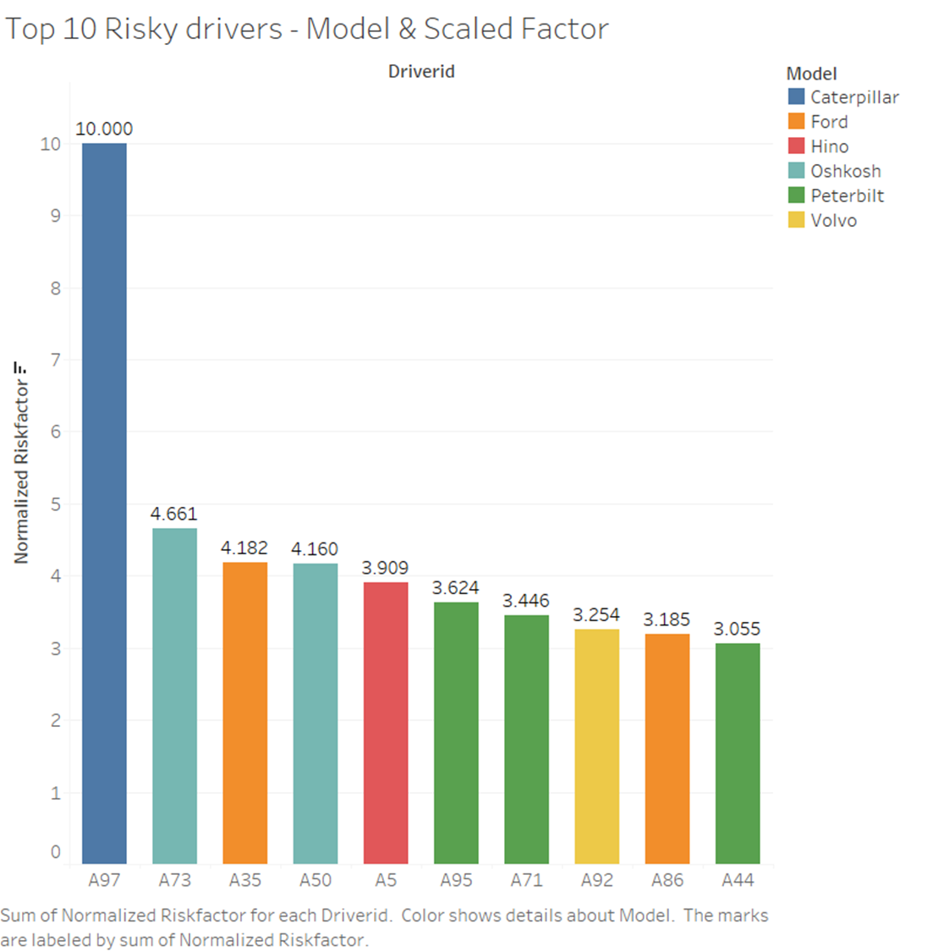
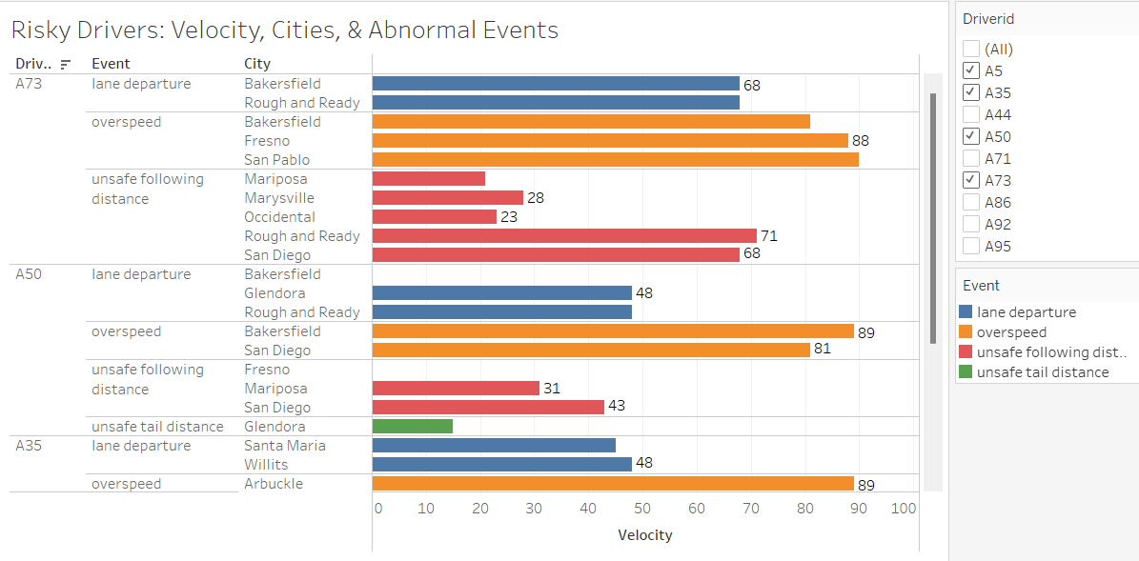
Top 10 Risky drivers

Slide 7
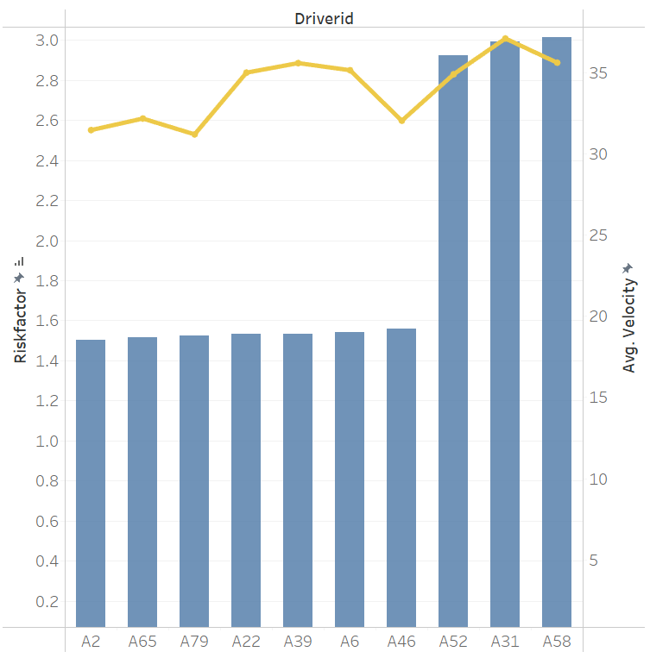
Top 10 Safest drivers

Slide 8
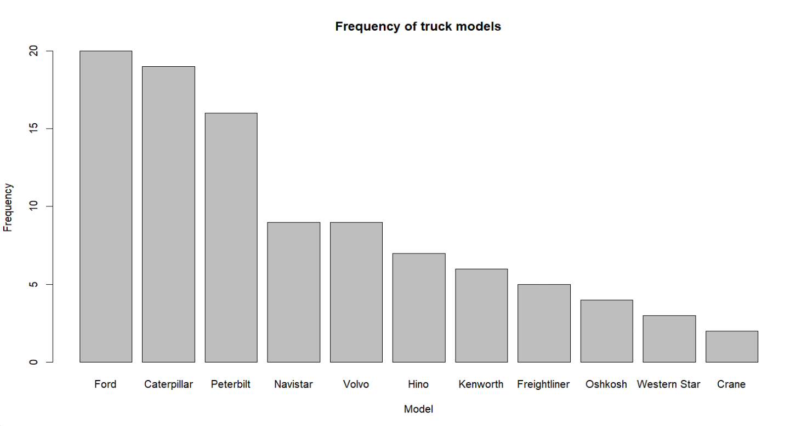
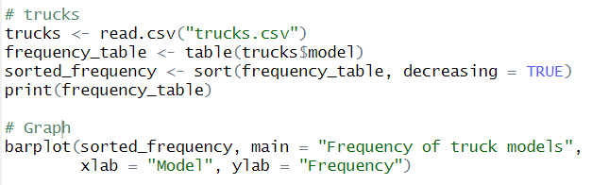
Analysis in R: Count by truck model
Associated with more risky events

Slide 9
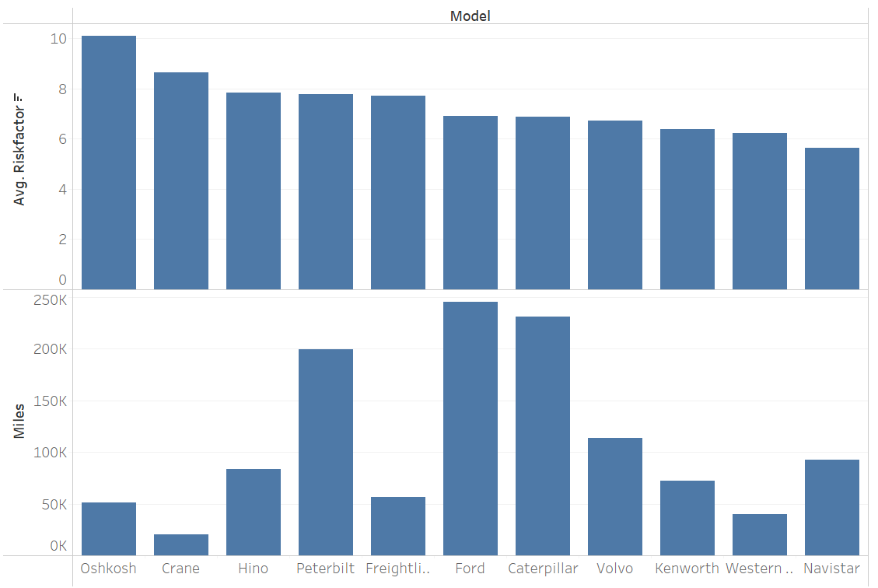
Total miles vs risk factor by truck model

Slide 10
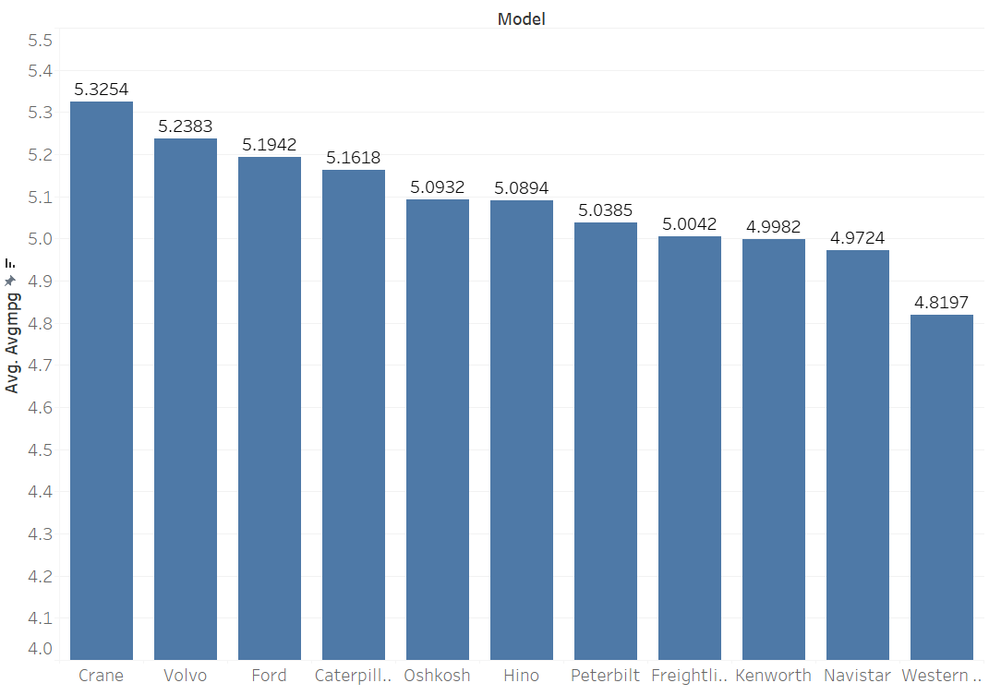
Most efficient truck models

Slide 11
CONCLUSION:
Santa Rosa and Willits are the cities with highest risk factors. Adding more safety indicators to avoid over speeding and lane departures is recommended.
Oshkosh and Crane have the highest risk factor. If budget permits, ANT can increase the number of trucks models with lower risk factor score.
For the trucks linked with high number of risky events such as overspeed, ANT can further investigate if the engine of those models is allowed or forced to go beyond its design limit.
Truck drivers with high-risk factor score and having higher number of unsafe events can be given regular training and driving tests. Review and regular update of telematics devices on vehicles and insurance policies which incentivizes driving behavior can help in improving road safety.

Slide 12

THANK YOU

